Slide 1
6
TECHNIQUES OF INTEGRATION

Slide 2
6.3
Partial Fractions

Slide 3
Partial Fractions
In this section we show how to integrate any rational function (a ratio of polynomials) by expressing it as a sum of simpler fractions, called partial fractions, that we already know how to integrate.

Slide 4
PARTIAL FRACTIONS
To illustrate the method, observe that by taking the fractions 2/(x – 1) and 1/(x – 2) to a common denominator we obtain

Slide 5
INTEGRATION BY PARTIAL FRACTIONS
If we now reverse the procedure, we see how to integrate the function on the right side of this equation:

Slide 6
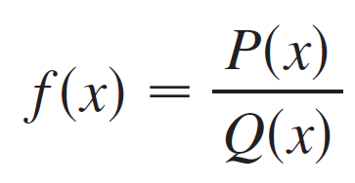
Partial Fractions
To see how the method of partial fractions works in general, let’s consider a rational function where P and Q are polynomials.
where P and Q are polynomials.

Slide 7
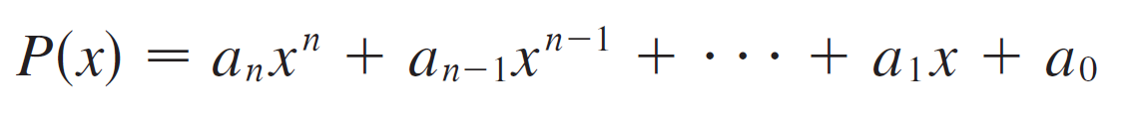
Partial Fractions
It’s possible to express f as a sum of simpler fractions provided that the degree of P is less than the degree of Q.
Such a rational function is called proper.
We have known that if
where a_{n} ≠ 0, then the degree of P is n and we write deg(P) = n.

Slide 8
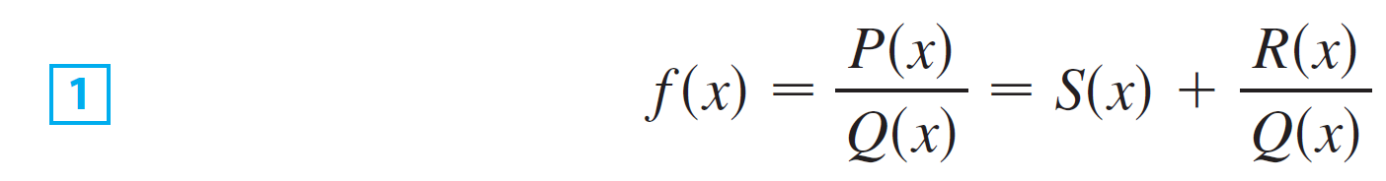
Partial Fractions
If f is improper, that is, deg(P) ≥ deg(Q), then we must take the preliminary step of dividing Q into P (by long division) until a remainder R(x) is obtained such that deg(R) < deg(Q).
The division statement is
where S and R are also polynomials.

Slide 9
Example 1
Find
SOLUTION
The degree of the numerator is greater than that of the denominator.
So, we first perform the long division.
This enables us to write:

Slide 10
Partial Fractions
The next step is to factor the denominator Q(x) as far as possible.
It can be shown that any polynomial Q can be factored as a product of linear factors (of the form ax + b) and irreducible quadratic factors (of the form ax² + bx + c, where b² – 4ac < 0).
For instance, if Q(x) = x4 – 16, we could factor it as:

Slide 11
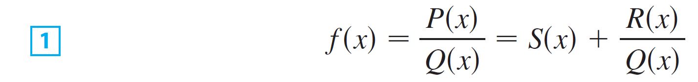
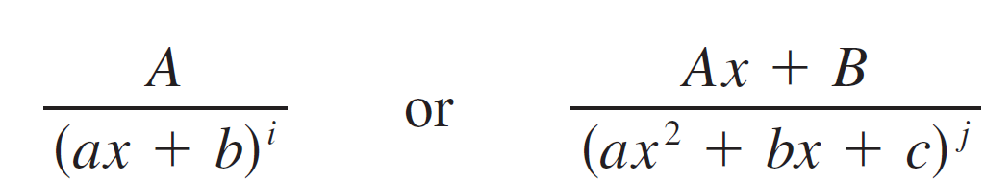
Partial Fractions
The third step is to express the proper rational function R(x)/Q(x) (from Equation 1)
as a sum of partial fractions of the form

Slide 12
Partial Fractions
A theorem in algebra guarantees that it is always possible to do this. We explain the details for the four cases that occur.
CASE I The denominator Q(x) is a product of distinct linear factors.
This means that we can write
where no factor is repeated (and no factor is a constant multiple of another).

Slide 13
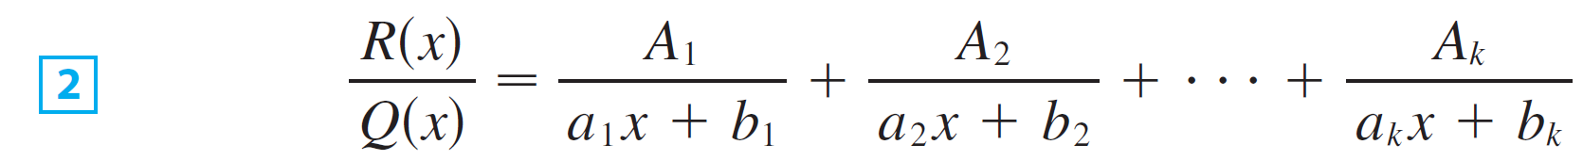
Partial Fractions
In this case the partial fraction theorem states that there exist constants A₁, A₂, …, A_{k} such that

Slide 14
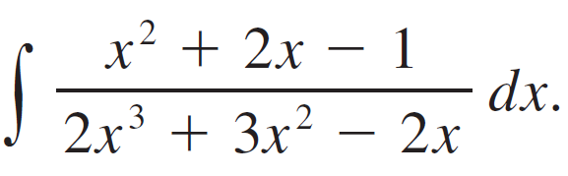
Example 2
Evaluate
SOLUTION:
Since the degree of the numerator is less than the degree of the denominator, we don’t need to divide.
We factor the denominator as

Slide 15

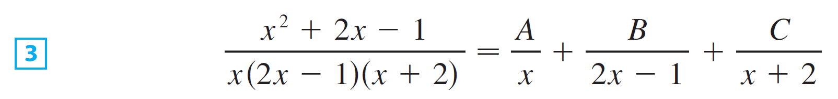

Example 2 – Solution
Since the denominator has three distinct linear factors, the partial fraction decomposition of the integrand has the form
To determine the values of A, B, and C, we multiply both sides of this equation by the product of the denominators,
obtaining

Slide 16
Example 2 – Solution
Expanding the right side of Equation 4 and writing it in the standard form for polynomials, we get
The polynomials in Equation 5 are identical, so their coefficients must be equal.
The coefficient of x² on the right side, 2A + B + 2C, must equal the coefficient of x² on the left side—namely, 1.

Slide 17
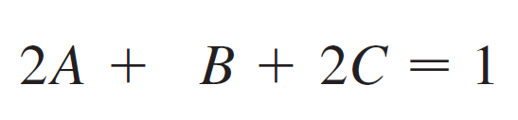
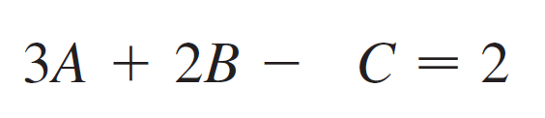

Example 2 – Solution
Likewise, the coefficients of x are equal and the constant terms are equal.
This gives the following system of equations for A, B, and C:

Slide 18

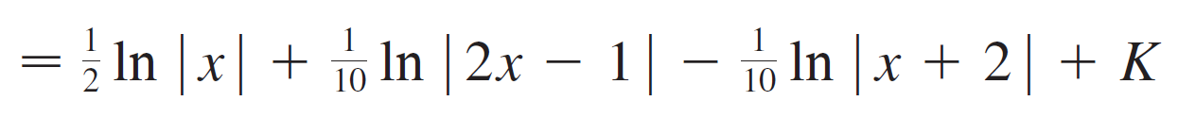
Example 2 – Solution
Solving, we get and so
In integrating the middle term we have made the mental substitution u = 2x – 1, which gives

Slide 19
NOTE
We can use an alternative method to find the coefficients A, B, and C in Example 2.
Equation 4 is an identity.
It is true for every value of x.
Let’s choose values of x that simplify the equation.

Slide 20
NOTE
If we put x = 0 in Equation 4, the second and third terms on the right side vanish, and the equation becomes –2A = –1.
Hence, A = ½.
Likewise, x = ½ gives 5B/4 = 1/4 and x = –2 gives 10C = –1.
Hence, B = 1/5 and C = –1/10.

Slide 21
NOTE
You may object that Equation 3 is not valid for x = 0, ½, or –2.
So, why should Equation 4 be valid for those values?
In fact, Equation 4 is true for all values of x, even x = 0, ½, and –2 .
See Exercise 45 for the reason.

Slide 22
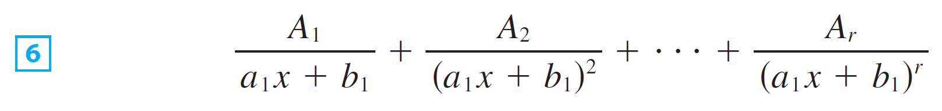
Partial Fractions
CASE II Q(x) is a product of linear factors, some of which are repeated.
Suppose the first linear factor (a₁x + b₁) is repeated r times; that is, (a₁x + b₁)^{r} occurs in the factorization of Q(x).
Then instead of the single term A₁/(a₁x + b₁) in Equation 2, we would use

Slide 23
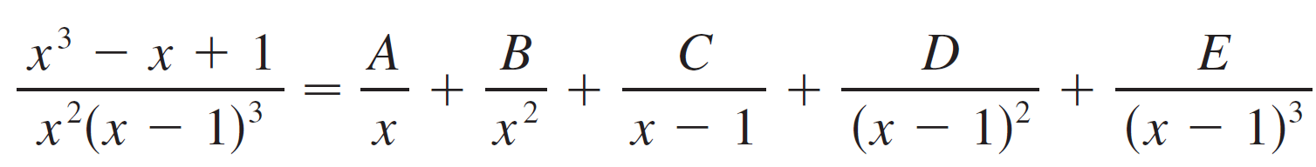
Partial Fractions
By way of illustration, we could write

Slide 24
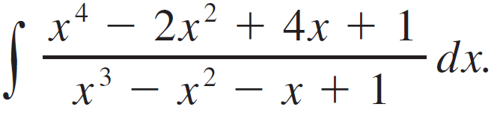
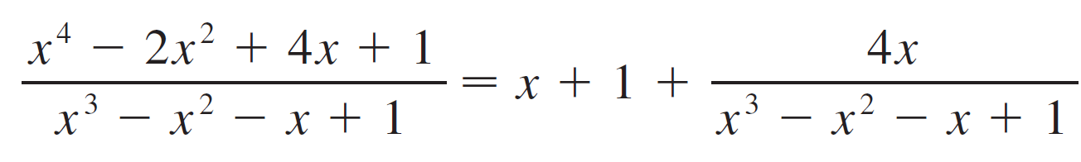

Example 3
Find
SOLUTION:
The first step is to divide. The result of long division is
The second step is to factor the denominator

Slide 25

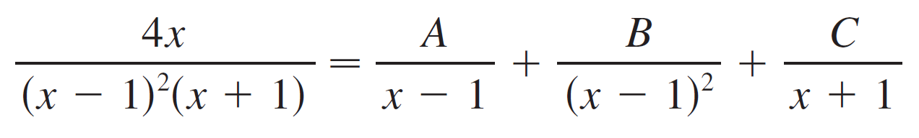
Example 3 – Solution
Since Q(1) = 0, we know that x – 1 is a factor and we obtain
Since the linear factor x – 1 occurs twice, the partial fraction decomposition is

Slide 26
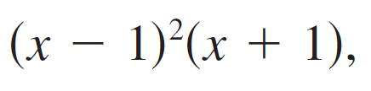
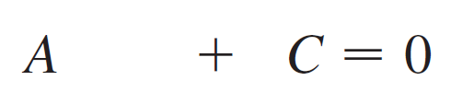
Example 3 – Solution
Multiplying by the least common denominator, we get
Now we equate coefficients:

Slide 27


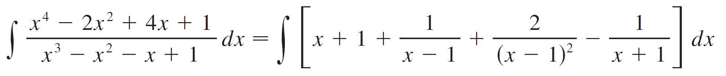
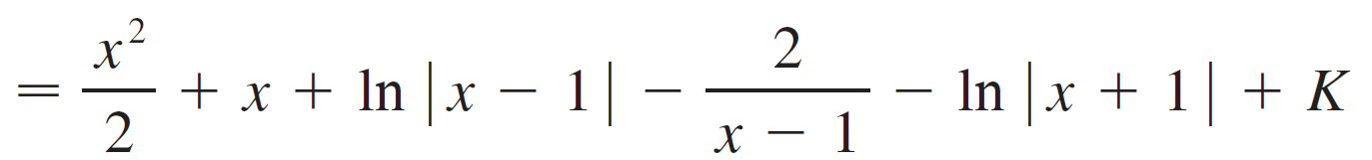
Example 3 – Solution
Solving, we obtain A = 1, B = 2, and C = –1, so

Slide 28
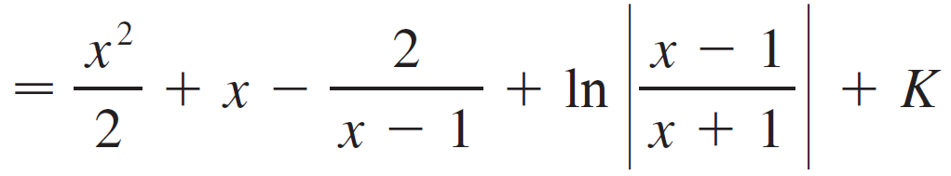
Example 3 – Solution

Slide 29
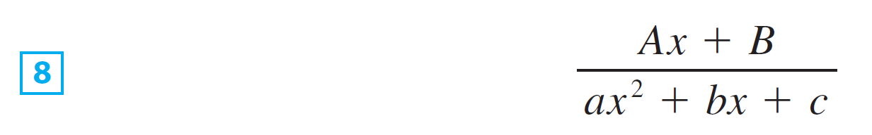
Partial Fractions
CASE III Q(x) contains irreducible quadratic factors, none of which is repeated.
If Q(x) has the factor ax² + bx + c, where b² – 4ac < 0, then, in addition to the partial fractions in Equations 2 and 6, the expression for R(x)/Q(x) will have a term of the form
where A and B are constants to be determined.

Slide 30
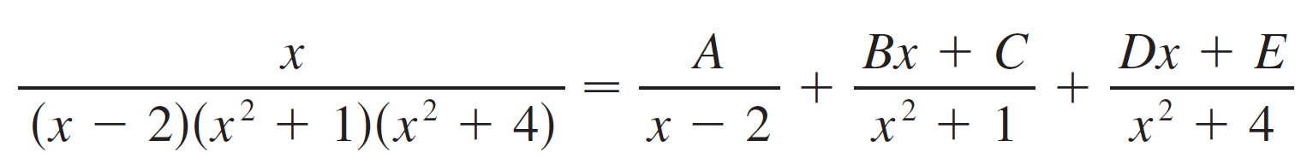

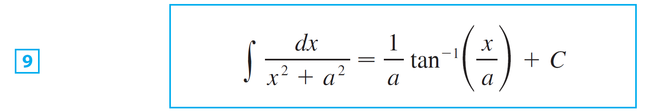
Partial Fractions
For instance, the function given by f (x) = x/[(x – 2)(x² + 1)(x² + 4)] has a partial fraction decomposition of the form
The term in can be integrated by completing the square (if necessary) and using the formula

Slide 31
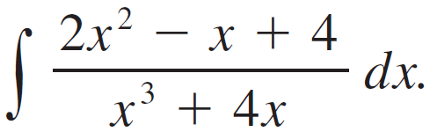

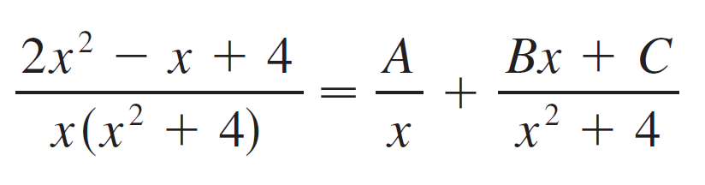
Example 4
Evaluate
SOLUTION: Since can’t be factored further, we write

Slide 32

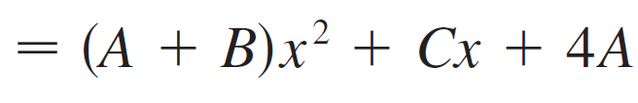
Example 4 – Solution
Multiplying by we have
Equating coefficients, we obtain

Slide 33
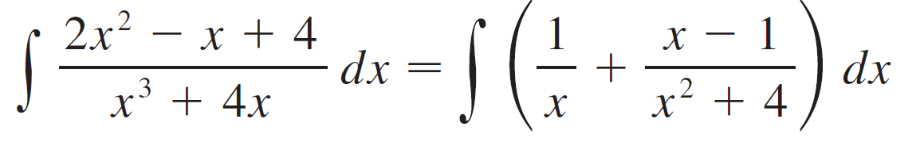
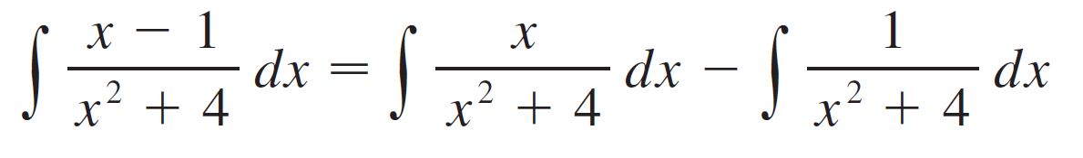
Example 4 – Solution
Thus A = 1, B = 1, and C = –1 and so
In order to integrate the second term we split it into two parts:

Slide 34
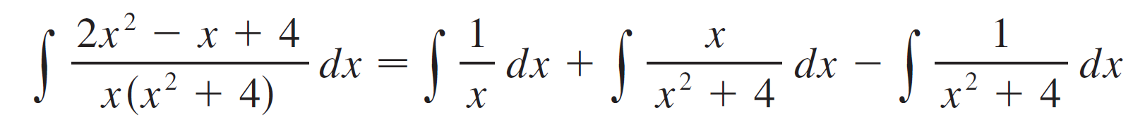
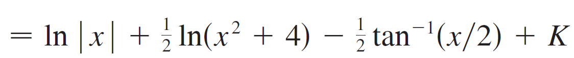
Example 4 – Solution
We make the substitution u = x² + 4 in the first of these integrals so that du = 2x dx.
We evaluate the second integral by means of Formula 9 with a = 2:

Slide 35
Example 5
Evaluate
SOLUTION
The degree of the numerator is not less than the degree of the denominator.
So, we first divide and obtain:

Slide 36
Example 5 – Solution
Notice that the quadratic 4x² – 4x + 3 is irreducible because its discriminant is b² – 4ac = – 32 < 0.
This means it can’t be factored.
So, we don’t need to use the partial fraction technique.

Slide 37
Example 5 – Solution
To integrate the function, we complete the square in the denominator:
This suggests we make the substitution u = 2x – 1.
Then, du = 2 dx, and x = ½(u + 1).

Slide 38
Example 5 – Solution
Thus,

Slide 39
NOTE
Example 5 illustrates the general procedure for integrating a partial fraction of the form

Slide 40
NOTE
We complete the square in the denominator and then make a substitution that brings the integral into the form
Then, the first integral is a logarithm and the second is expressed in terms of tan^{–1}.

Slide 41

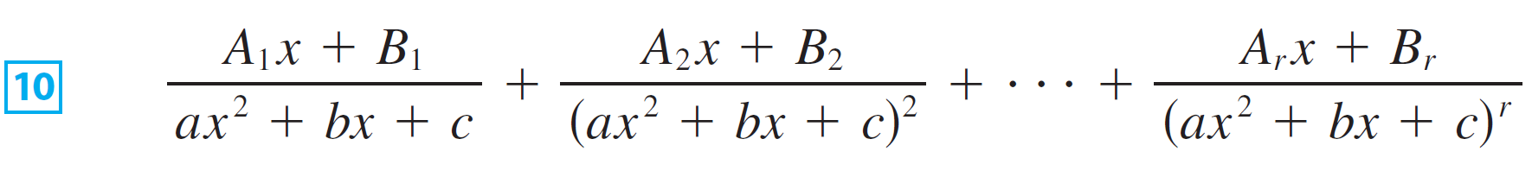

Partial Fractions
CASE IV Q(x) contains a repeated irreducible quadratic factor.
If Q(x) has the factor (ax² + bx + c)^{r}, where b² – 4ac < 0
then instead of the single partial fraction the sum
occurs in the partial fraction decomposition of .

Slide 42

Partial Fractions
Each of the terms in can be integrated by completing the square and using a substitution (if necessary).

Slide 43
Example 6
Write out the form of the partial fraction decomposition of the function

Slide 44
Example 6 – Solution

Slide 45
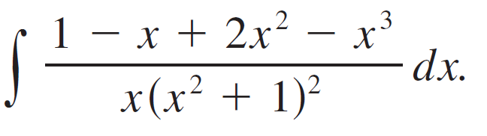
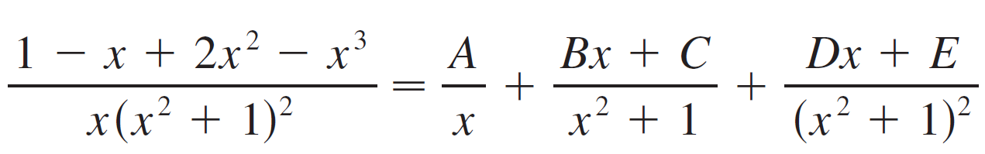
Example 7
Evaluate
SOLUTION: The form of the partial fraction decomposition is

Slide 46

Example 7 – Solution
Multiplying by we have

Slide 47
Example 7 – Solution
If we equate coefficients, we get the system
which has the solution

Slide 48
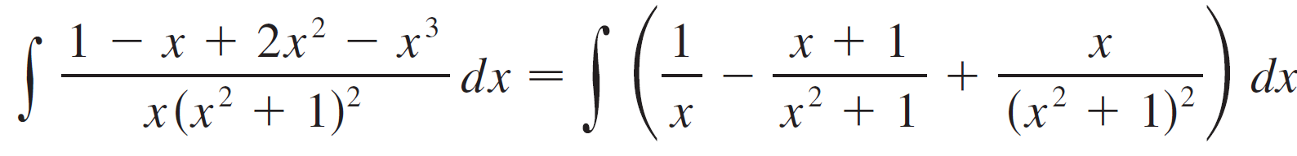
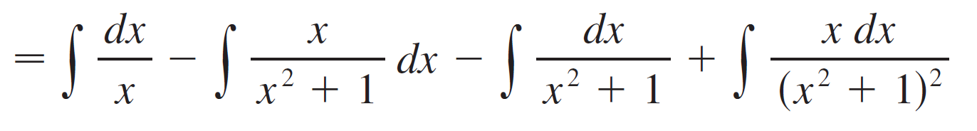
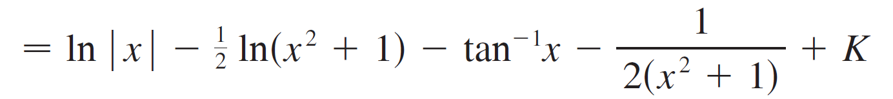
Example 7 – Solution
Thus

